Slide 1


Tree leaf recognition
Rufus Roisch & Hedda Bonatz Machine Learning with Tensorflow SoSe 2023

Slide 2
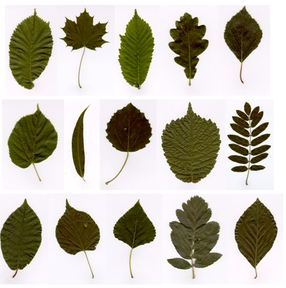
Data
15 tree leaf types with 75 images each → 1125 images
RGB images
Single leaf on a white background → Bias
Preprocessing:
Resize the images (300x150x3)
Shuffle and split into training and test data
→ Train: 900 | Test: 225
Söderkvist 2001
Notes:
Most freely available datasets look into plants in general and often the plants are not native in Germany
Dataset from a master thesis from the university of Linkoping covering tree leaves like the field elm and the cottonwood that are mostly native in the Northern Hemisphere, so also here in Germany

Slide 3
Why we chose this Dataset
Contained tree species: Feldulme Ahorn Ohr-Weide Eiche Grau-Erle Moor-Birke Silber-Weide Espe Bergulme Eberesche Asch-Weide Pappel Linde Schwedische Mehlbeere Rotbuche
It contains known and local tree species
Notes:
the university of Linkoping in Sweden

Slide 4
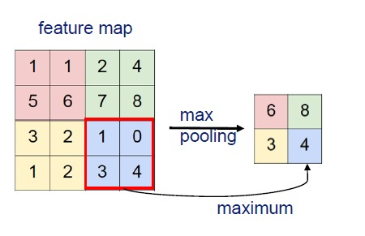
Recap: layers
MaxPooling-Layer Convolution-Layer

Slide 5
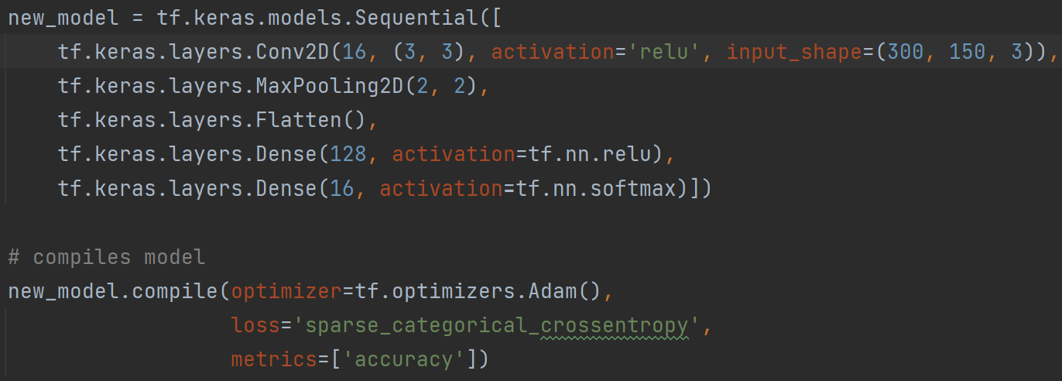
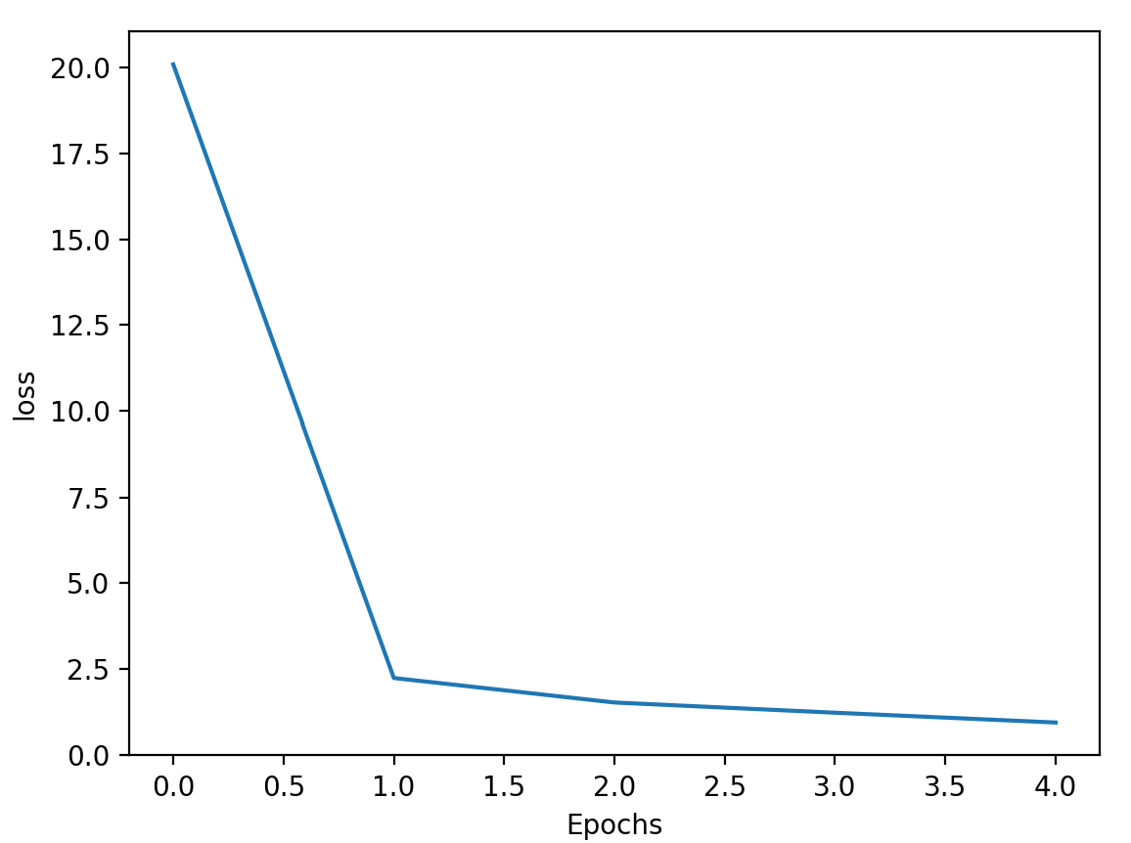
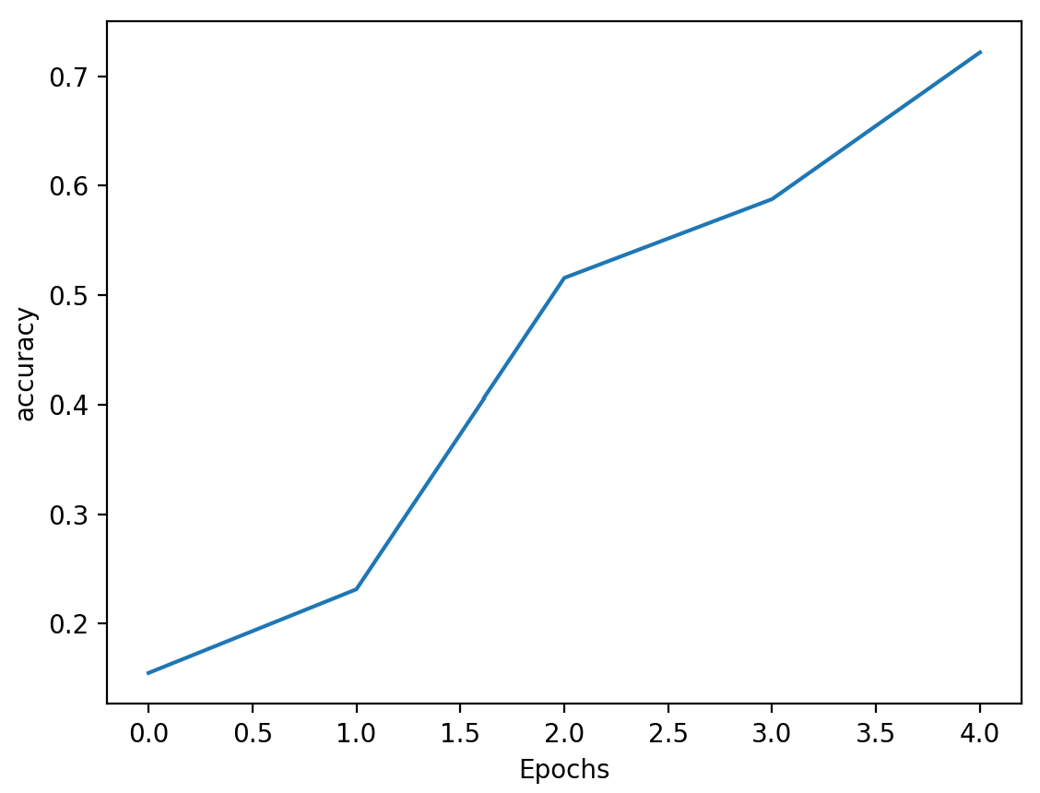
Basemodel
Starting off with only one Convolution layer and one MaxPooling layer
Result:
- It is learning something!
- Already an 64% validation accuracy

Slide 6
Improving the Basemodel
What we tried:
Adding more layers
Adjusting the amount of epochs
Trying different optimizer
Trying different loss functions
What worked:
- Adding layers - Tweaking layer parameters - More epochs

Slide 7
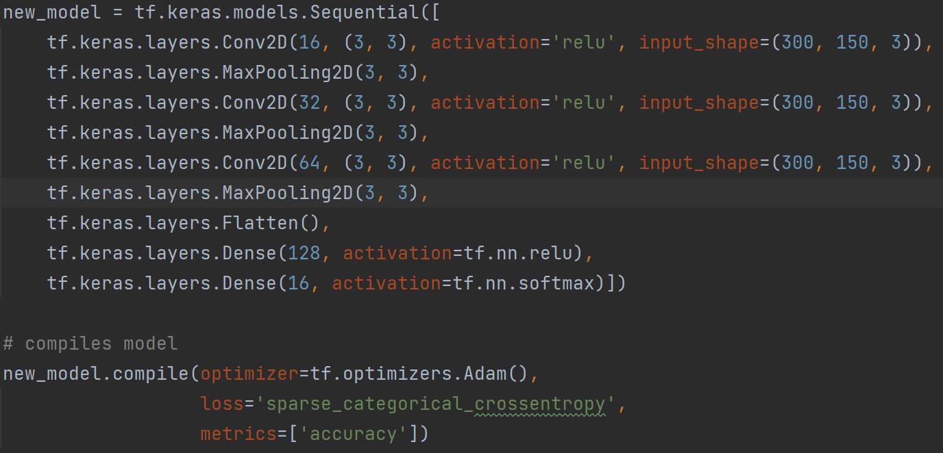
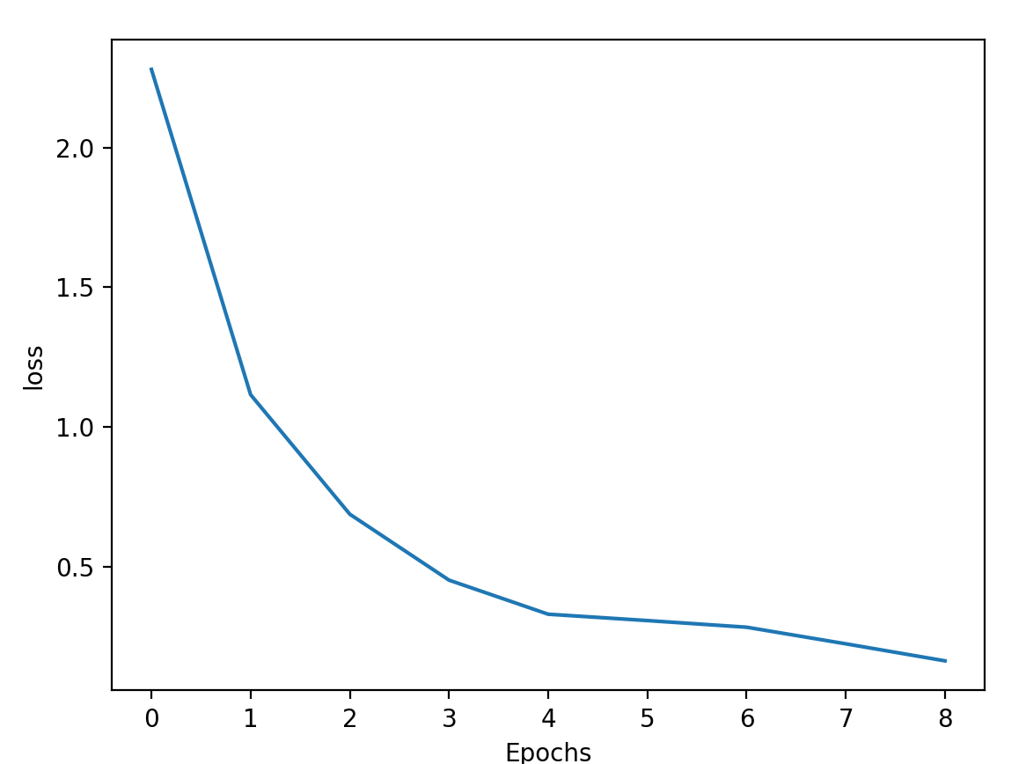
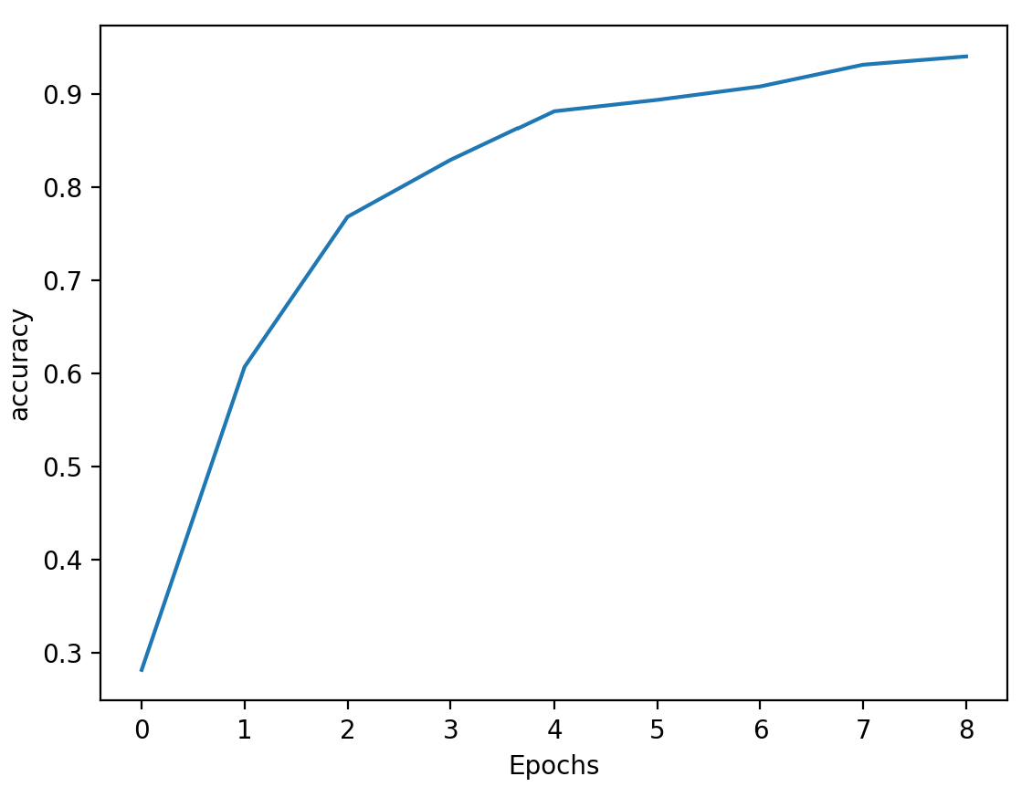
The improved basemodel
3 Convolution and 3 MaxPool layers
9 Epochs
Result:
- 90% validation accuracy

Slide 8
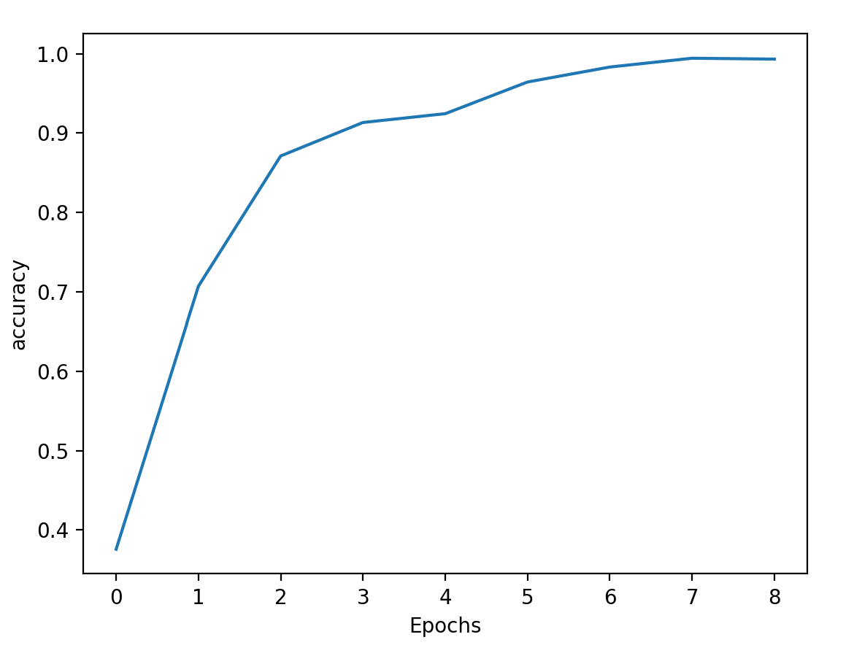
Effeciency vs Accuracy
800 x 400 pixel pictures vs 300 x 150 pixels
Validation acc.: 91% Validation acc.: 90%
Run time: ~ 15min Run Time: ~ 86s

Slide 9
Color Changes
Color scheme | Validation loss | Validation accuracy | Run time
RGB | 0.52 | 0.90 | 86s
BW | 0.43 | 0.86 | 100s
HSV | 0.42 | 0.88 | 139s
Changing the color settings marginally influences the performance
Leafs have different colors depending on season and health status → HSV color scheme might be a good option
Notes:
Black and White:
Validation loss: 0.62 | Validation accuracy: 0.81 (5 epochs, max pool 2x2)
Validation loss: 0.43 | Validation accuracy: 0.86 (9 epochs, max pool 3x3)
HSV (Hue, Saturation, Value changes):
Separates color from brightness (more robust to changes in lighting conditions; better in detecting objects of different color; simplicity)
Validation loss: 0.64 | Validation accuracy: 0.82 (5 epochs, max pool 2x2)
Validation loss: 0.42 | Validation accuracy: 0.88 (9 epochs, max pool 3x3)

Slide 10
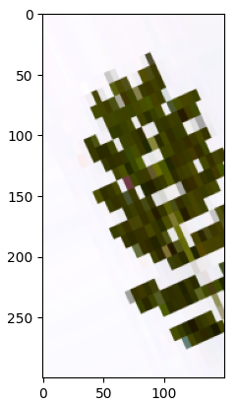
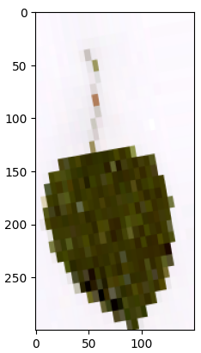
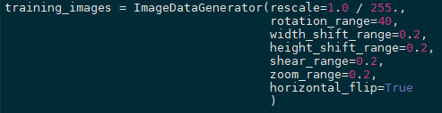
Augmentation
Massively degrades the performance of the model
Validation loss: ~ 2.5
Validation accuracy: ~ 0.1
Our dataset is already so neat and structured that augmentation is not reasonable

Slide 11
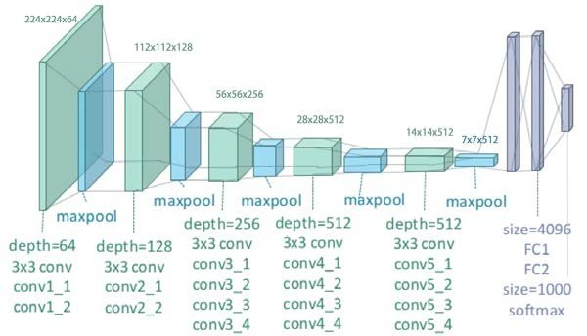
Transfer Learning with VGG19
Developed by the University of Oxford in 2014 (Simonyan & Zisserman)
Very deep CNN with more layers
Small convolution filters with size 3x3
Layers: 16 Convs, 3 dense, 5 max pool
Parameters: 143 M
Top-1 Accuracy: 74,4 %
Yang et al. 2018
Notes:
Top-1 Accuracy: Calculates the percentage of instances where the prediction matches the ground truth label for the class with the highest probability.

Slide 12
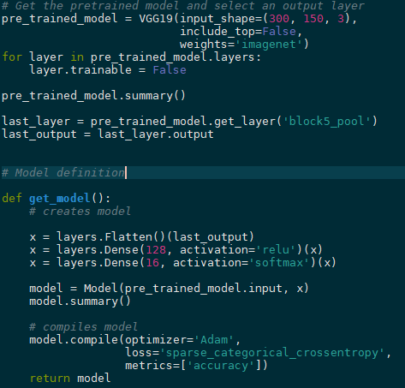
Implementation VGG19
Freezing the weights after the 5th pooling layer
Using the pooling layer as input for the flattened layer
Notes:
5 epochs

Slide 13
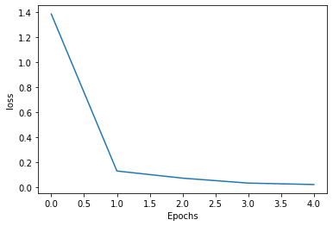
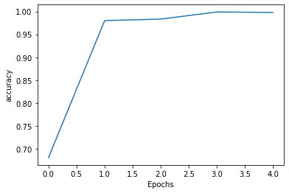
Implementation VGG19
Validation loss: 0.1
Validation accuracy: 0.97
→ Training the model is much slower: ~ 9 min/epoch vs 7 s/epoch
Notes:
5 epochs

Slide 14
Difficulties
Different working environments (Colab, PyCharm)
Git(small merge problems)
Setting up tensorflow on private machine (GPU not working)
Unsolved difficulties:
Using Augmentation: Different output layer size compared to the basemodel?
Untidy Project

Slide 15
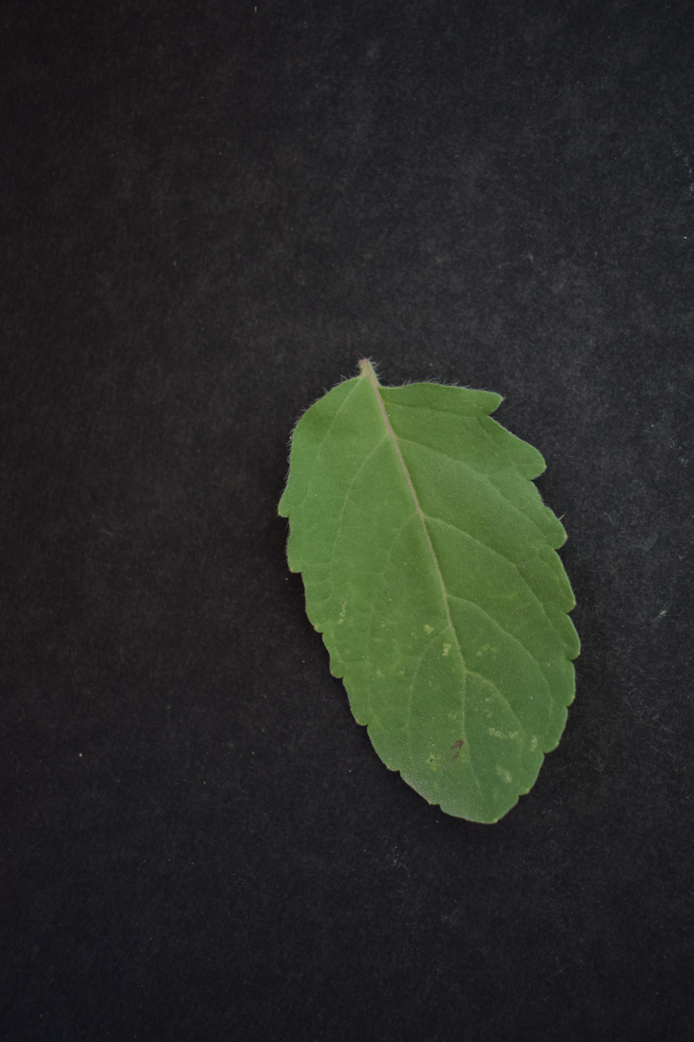
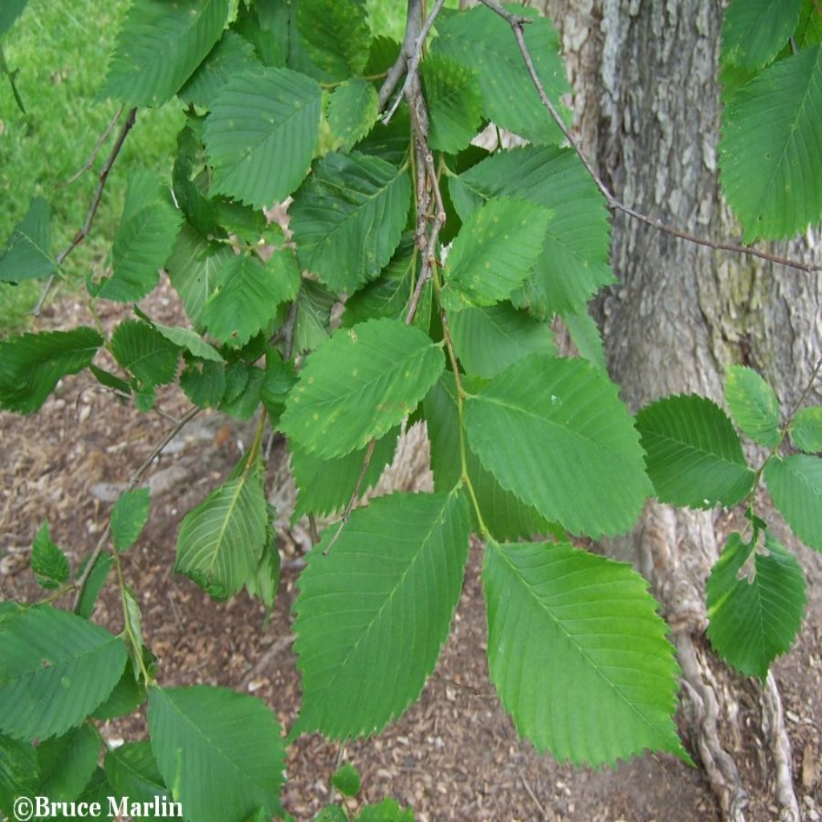
Outlook
Train with a bigger variety of tree species
Train with more realistic pictures → to make the model usable outside of this dataset
Identify tree leafs in different conditions (healthy/unhealthy)
tensorflow.org
kaggle.com

Slide 16
Thank you for listening

